Slide 1

Lecture 9
Architectural Design

Slide 2

Learning Outcomes
Understand why the architectural design of software is important
Understand the decisions that have to be made about the system architecture during the architectural design process
Introduced to the three complementary architectural styles covering the overall system organization, modular decomposition and control;
Understand how reference architectures are used to communicate architectural concepts and to assess system architectures.

Slide 3
What is Architectural design
It is the process of identifying the major components of a system and the communications between these components.
The output of this design process is a description of the software architecture.

Slide 5

Why Architectural design is important
Stakeholder communication The architecture is a high-level presentation of the system that may be used as a focus for discussion by a range of different stake-holders.
System analysis Making the system architecture explicit at an early stage in the system development requires some analysis. Architectural design decisions have a profound effect on whether the system can meet critical requirements such as performance, reliability and maintainability.
Large-scale reuse A system architecture model is a compact, manageable description of how a system is organised and how the components interoper-ate. The system architecture is often the same for systems with similar require-ments and so can support large-scale software reuse. As I discuss in Chapter 18, it may be possible to develop product-line architectures where the same architecture is used across a range of related systems.

Slide 6
Reusability: Using a component in a different system
Usability: How easy to use the system

Slide 7
Architectural Design and Non-Functional Requirements
Performance : the architecture should be designed to localize critical operations within a small number of sub-systems, with as little communication as possible between these sub-systems
Security: a layered structure for the architecture should be used, Having the most critical assets protected in the innermost layers and with a high level of security validation applied to these layers.
Safety: the architecture should be designed so that safety-related operations are all located in either a single sub-system or in a small number of sub-systems. This reduces the costs and problems of safety validation and makes it possible to provide related protection systems.
Availability: the architecture should be designed to include redundant components (Fault-tolerant )and so that it is possible to replace and update components without stopping the system.
Maintainability: the system architecture should be designed using finegrain, self-contained components that may readily be changed. Producers of data should be separated from consumers and shared data structures should be avoided.

Slide 8

Sub-System Design using Block Diagram
Block diagrams present a high-level picture of the system structure
It is an abstract decomposition of a system into large-grain components, each of which may be a substantial system in its own right.
Block diagrams are used to describe sub-system design.
Each box in the diagram represents a sub-system. Boxes within boxes indicate that the sub-system has itself been decomposed to sub-systems
Arrows mean that data and or control signals are passed from sub-system to sub-system in the direction of the arrows.

Slide 9
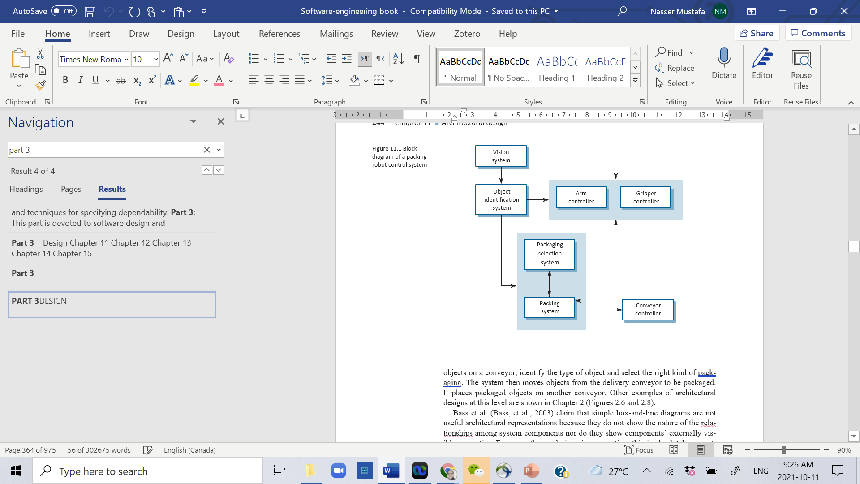
Block Diagram Example
Block diagram for a packing Robot Control System

Slide 10
Considerations on System design
Some software designers argue that component diagrams are not useful because they do not show the nature of the relationships among system components, nor do they show components’ externally visible properties.
This is true. However, this type of model is effective for communication with system stakeholders and for project planning because very simple
Decomposing a system into sub-systems is a hard decision.
System requirements are a major factor. The design should have aclose match between requirements and sub-systems.
If the requirements change, this change is likely to be localized rather than distributed across several sub-systems.

Slide 11
Categories of Design models
A static structural model: it shows the sub-systems or components that are to be developed as separate units.
A dynamic process model: it shows how the system is organized into processes at runtime.
An interface model: it defines the services offered by each sub-system through its public interface.
Relationship model: it shows relationships, such as data flow, between the sub-systems.
A distribution model: it shows how sub-systems may be distributed across computers.

Slide 12
System Organization
The organisation of a system reflects the basic strategy that is used to structure a system.
The decision on the overall organisational model of a system should be done early in the architectural design process.
The system organisation may be directly reflected in the subsystem structure.
The subsystem model includes more detail than the organisational model.

Slide 13

Organizational Styles
Organizational styles represent very widely used styles among software designers. These styles can be used separately or together These are:
Shared data repository style
Shared services and servers style
Abstract machine or layered style where the system is organised as a tier of functional layers.

Slide 14

Repository model
Sub-systems making up a system must exchange information so that they can work together effectively. There are two fundamental ways in which this can be done.
All shared data is held in a central database that can be accessed by all sub-systems. A system model based on a shared database is sometimes called a repos-itory model.
Each sub-system maintains its own database. Data is interchanged with other sub-systems by passing messages to them.

Slide 15
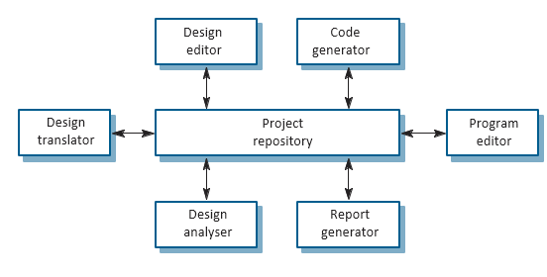
Repository Model Example

